Slide 1
CV and Academic Bio Workshop
Sarah K. Bruch

Slide 2
Agenda
Overview of CV content and organization
Example cvs
Tips for writing academic bios
Questions on CVs and academic bios
Feedback workshop of CV and bios

Slide 3
CV Basics
Primary document for applying for research and academic jobs.
Includes information on educational background, publications, grants, awards, fellowships, and other key achievements including previous professional jobs, teaching and research experience.
Length varies and gets longer as you accumulate more relevant accomplishments and experiences.

Slide 4
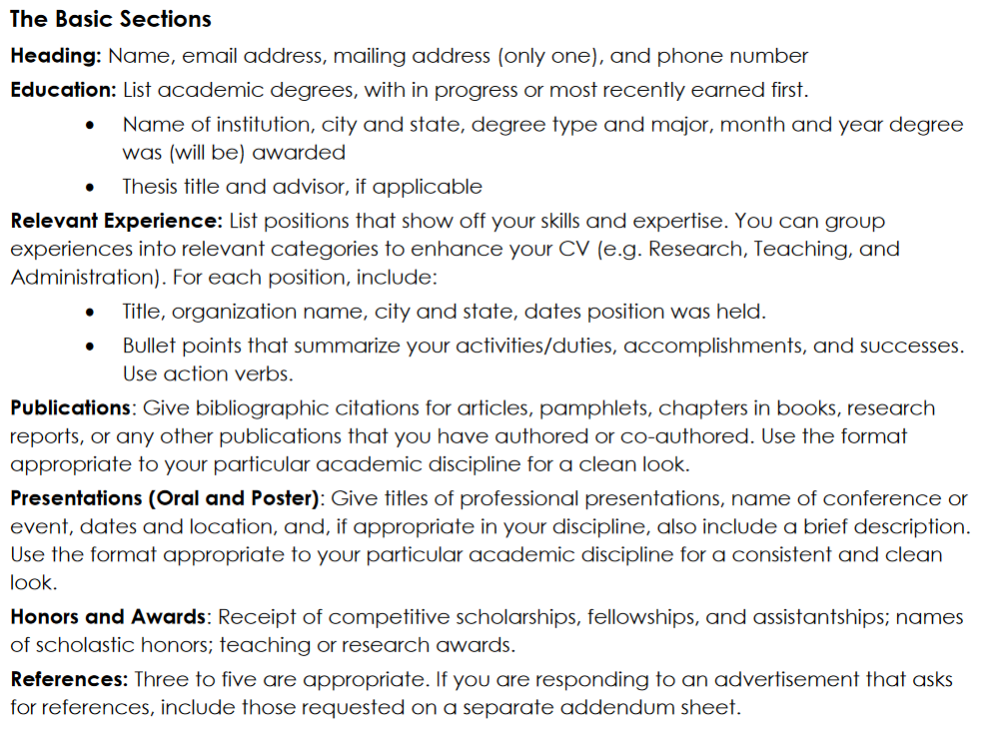
CV content

Slide 5
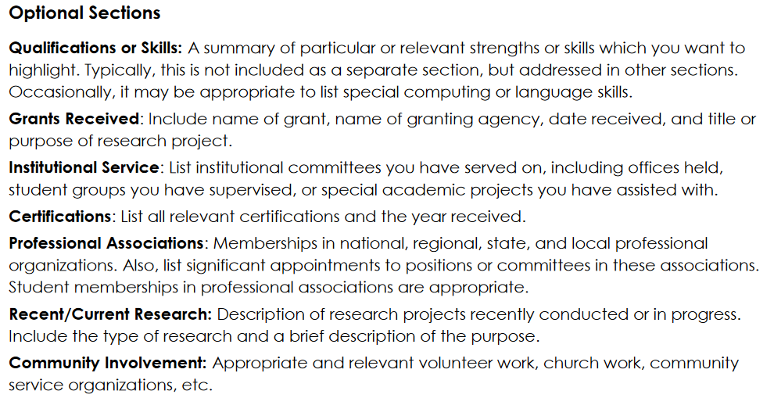
CV content

Slide 6
CV organization
Order of information is important and should be tailored to norms in your specific field.
Arrange sections to highlight strengths for the position you are seeking.
Research positions emphasize publications and research experience
Teaching positions emphasize teaching experience
Within each section, items should be listed in chronological order, the most recent appearing first.

Slide 7
Academic Bios - basics
Typically used for conferences, applying for fellowships and awards, listed on websites etc.
Basics include name, position, institution, then describe your research interests and main projects, and highlights of your accomplishments.
Usually very short 150-300 words

Slide 8
Academic Bios - Content
Recommended Content
Sarah Bruch is currently a PhD candidate at the University of Wisconsin, Madison.
Her research interests focus on …. Or Her research investigates…
Her dissertation ….
Her work has been published in … (or other statement of published research)
She is the recipient of … (list awards, fellowships or other honors)
Prior to graduate school she …. (describe relevant professional experience/positions)

Slide 9
Academic websites
Typical Content
Homepage w/ pic and short description w/ page links to:
CV
Research (w/ short project/paper descriptions and links to publications)
Teaching (w/ short teaching statement and list of course and links to syllabi)
UD Resources
Guidelines for Personal Websites (link)
Creating a WordPress Account (link)
Other Resources
Examples: see typical format examples (link)

Slide 10
Advice on cvs and bios
Create CV first year of graduate school, and update as you have relevant accomplishments, publications, presentations, etc.
Look at examples of faculty or researchers in your field to identify CV norms.
Look at examples of students, new faculty, or early career PhD researchers to see what is typical at that career stage.
Get feedback whenever you can - from advisors and faculty.

Slide 11
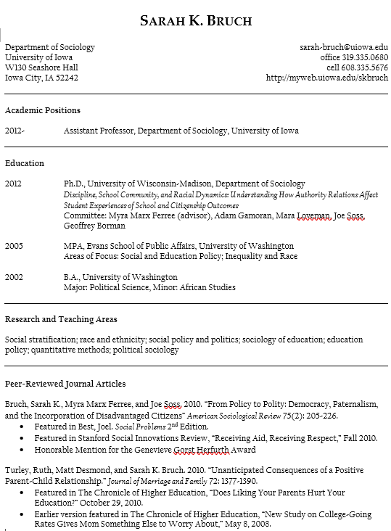
example

Slide 12
additional resources
University of Wisconsin CV Writing Tips (link)
Elsevier Writing an Effective Academic CV (link)
Cornell University Resumes and CVs (link)
Smith College CV for Academic and Research Roles (link)
Writing Your Academic or Professional Bio (link)
APPAM “Marketing Yourself: Job Document Review and Resume Writing” Session

Slide 13
Feedback workshop
Facilitated small group breakout rooms.
Opportunity for each student to share draft of CV or bio and receive feedback from group.

